Slide 1

NFL Player Data Analysis
By Chloe Drummond

Slide 2

Outline
INTRODUCTION
Data Cleaning
Exploratory Analysis
Models: Factorial ANOVA
MODELS: ANCOVA
Questions

Slide 3
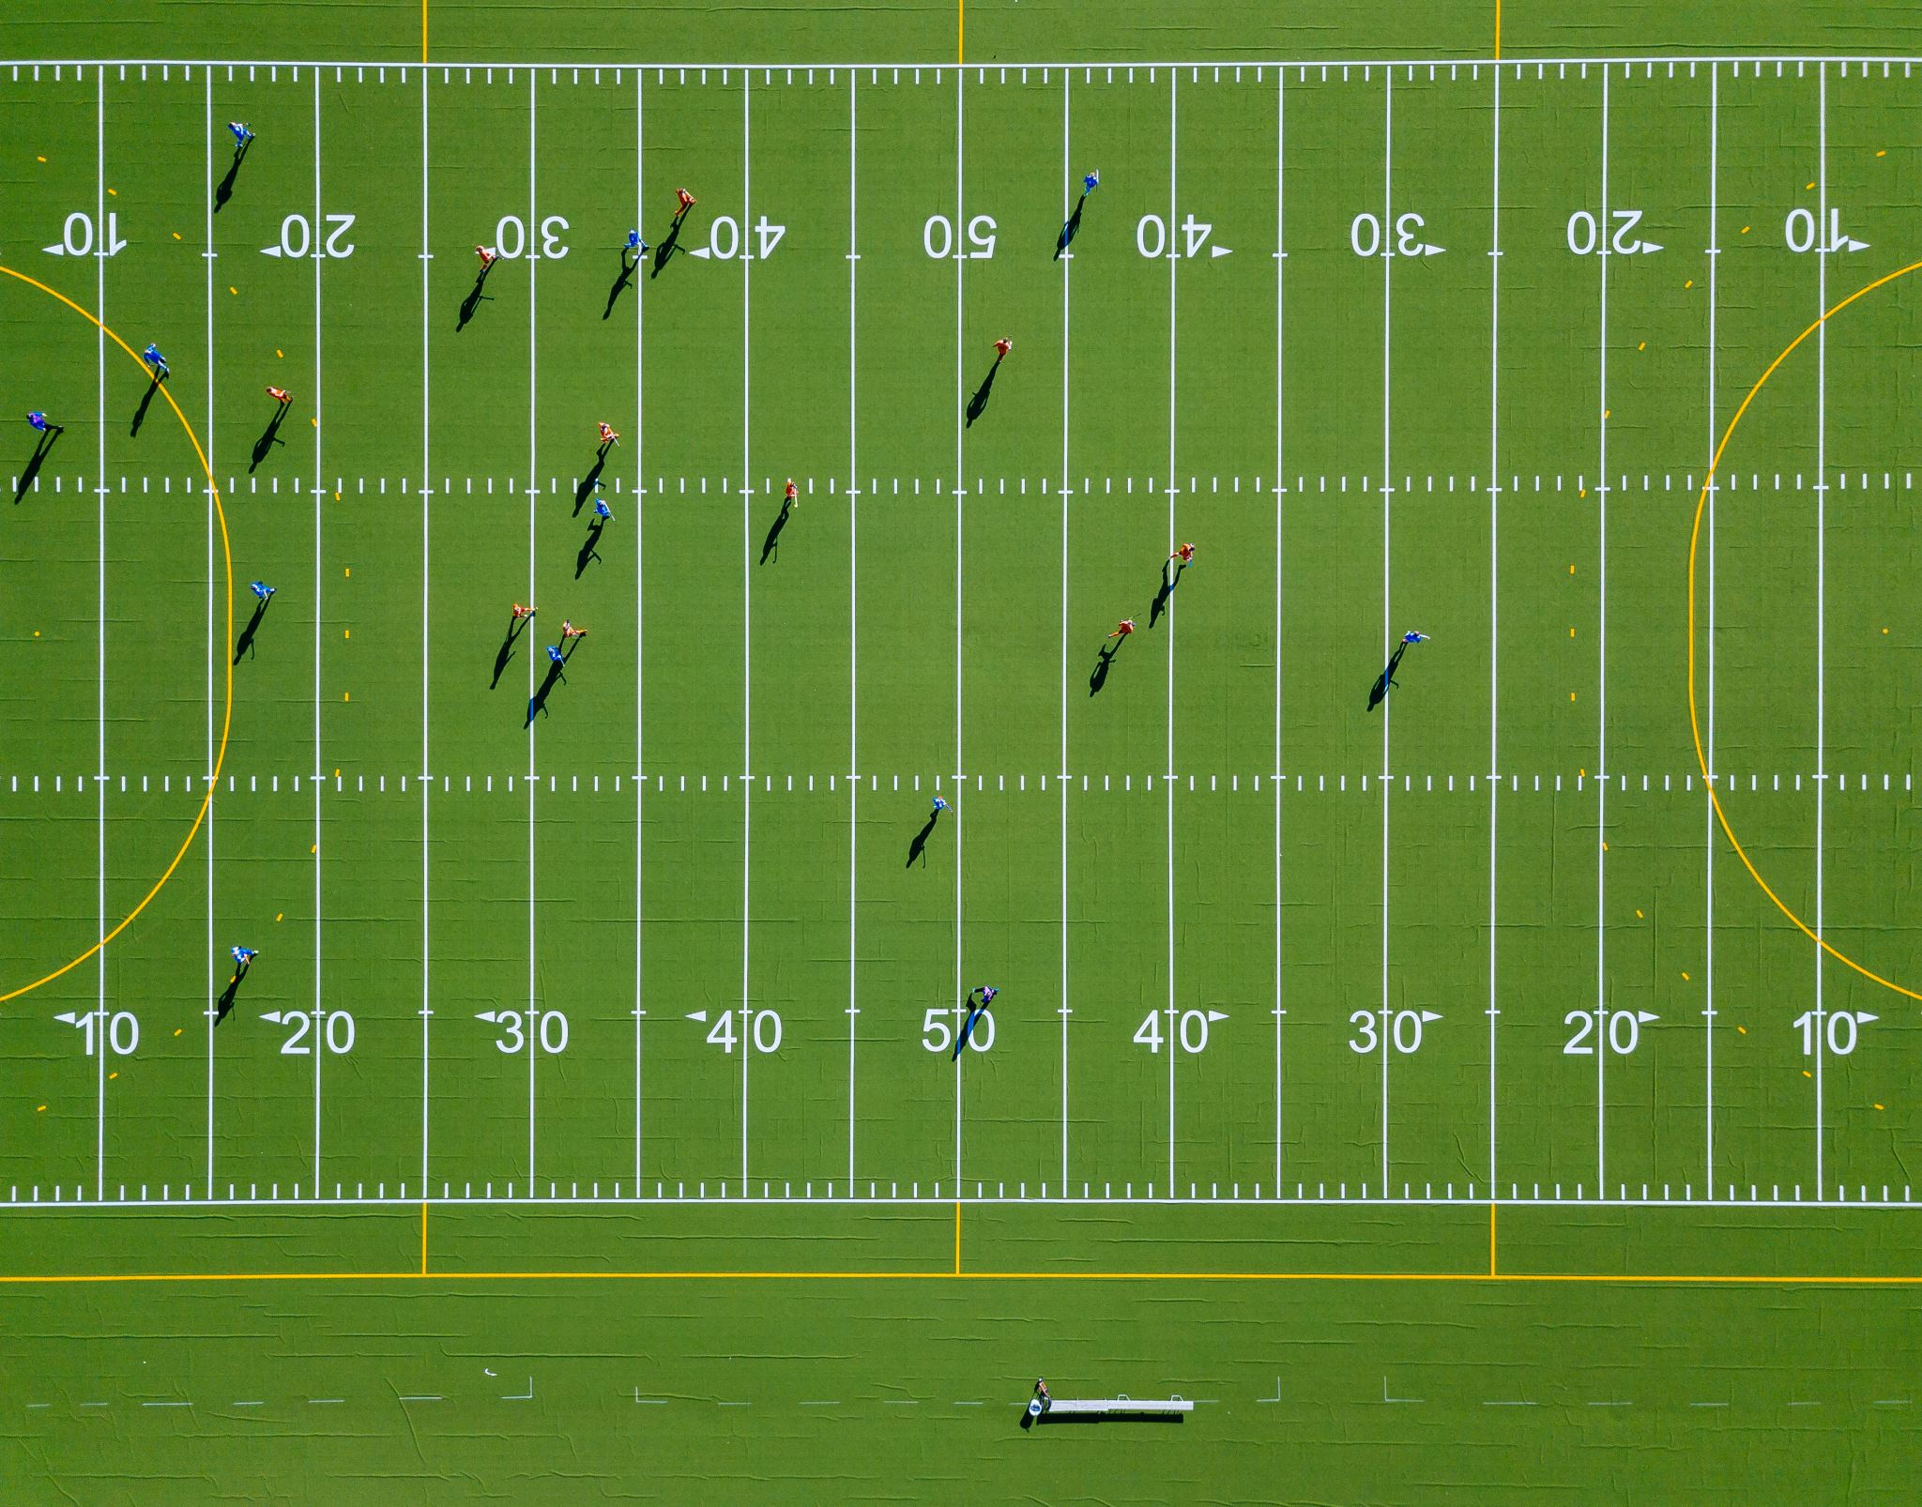
Introduction to NFL Data
Data Source
Background

Slide 4
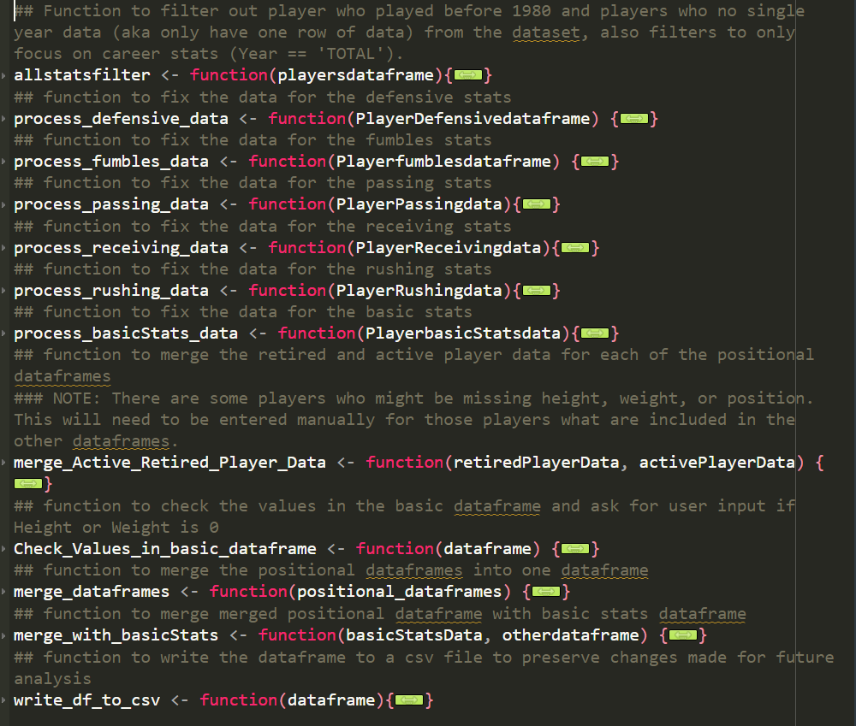
Data Cleaning Process
12 csv files with one common link of Player_Id
Many of the variable names in csv file were not accurate and/or poorly named for easy readability
A lot of missing data is present so to limit the amount but keep large sample I limited to Players after 1980.
Function allstatsfilter is called inside process_ functions
Created functions to process individual csv files to prepare the data for merging
Kept retired data and active data separated until merging but functions were designed to handle both
Some values needed to be manually inputted
Functions to merge individual dataframes and then merge into basic dataframe.
Exported cleaned data to csv files to preserve all changes made to be used in analysis

Slide 5
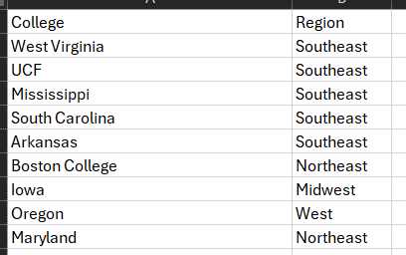
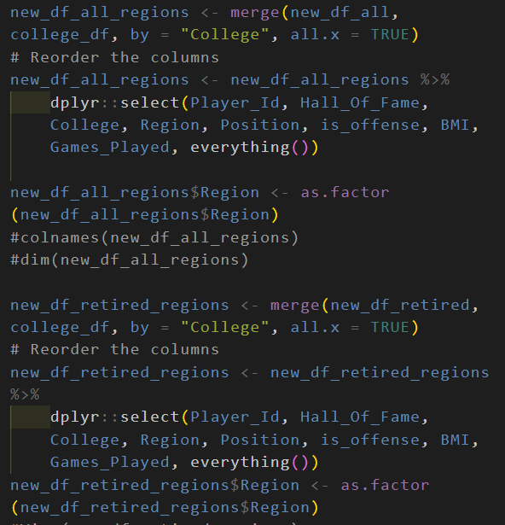
Data Cleaning Cont.
I also wanted to make use of the College variable
College had around 506 different levels, too many to use in model
Created csv file manually of Regions of the US where the College is located.
West, Midwest, NorthEast, Southwest, SouthEast, No College, International
Also reorders my columns to prepare for exploratory analysis

Slide 6
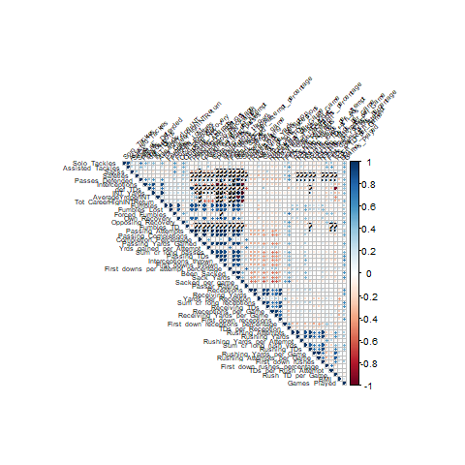
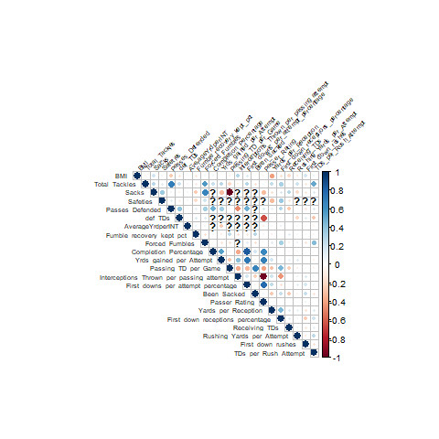
Exploratory Analysis
Correlation plot before variable fixing
Correlation plot after variable fixing
A mess

Slide 7
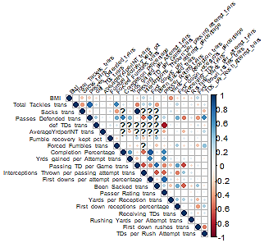
Transformations
Histograms evaluated for all variables to determine if transformation is needed
Functions were created to perform Log, Inverse, Square Root, and Cube Root transformations and produce histograms
At the end 16 transformations were conducted
Variables that were transformed had _trans added to the variable name
Still had some high correlations (more extreme than 0.7)

Slide 8
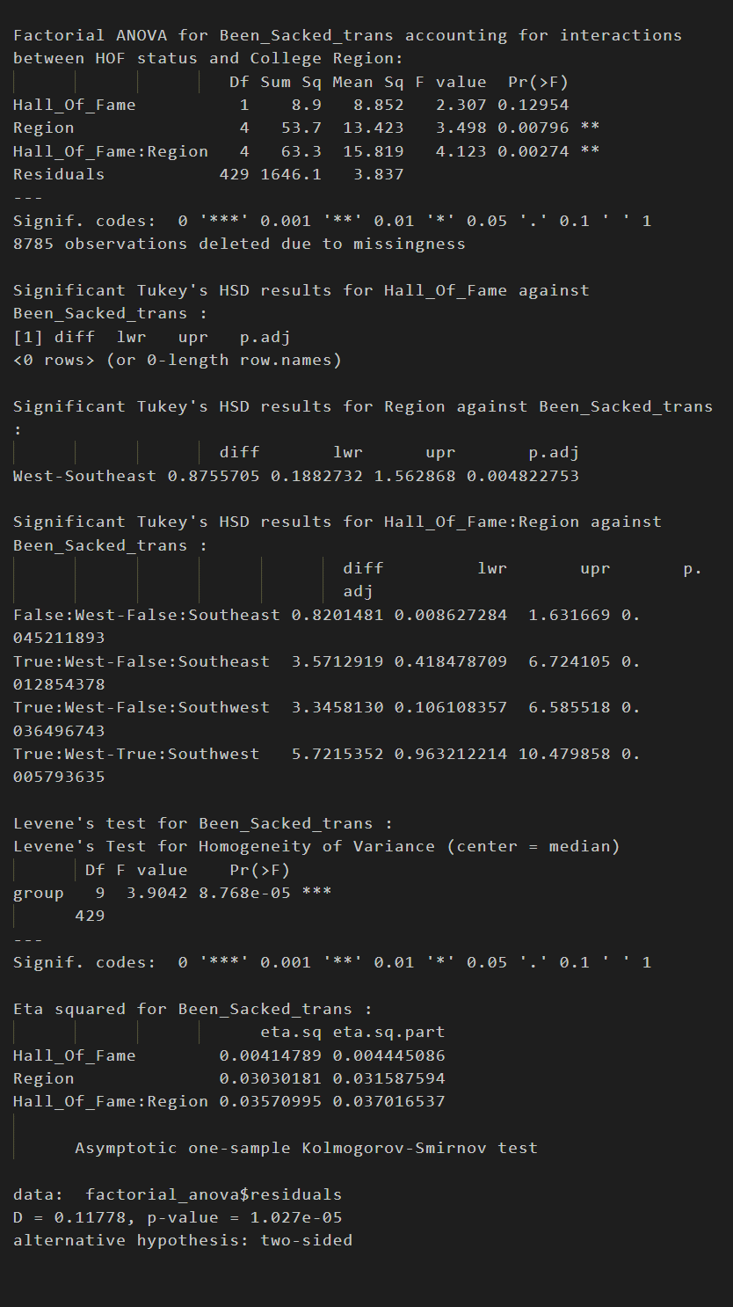
Models: Factorial ANOVA
Factorial ANOVA to test if there is a difference in performance metrics by the players hall of fame status and region where they attended college.
Examined only retired players since players who retired in 2019 which would be recorded as retired in this data, are eligible for the 2024 hall of fame class
Functions created to test against all metrics, creates interaction plots and tests all assumptions and prints output to txt file. Function also created for offense and defense groups
Metrics with significant results for ungrouped are
Receiving_TDs_trans, Yards_per_Reception, Been_Sacked_trans, Yrds_gained_per_Attempt, Completion_Percentage, Forced_Fumbles_trans, Total_Tackles_trans, BMI
Hall of fame status was more significant than Region for most of the metrics
Normality assumption violated for all metrics but is better after transformations

Slide 9
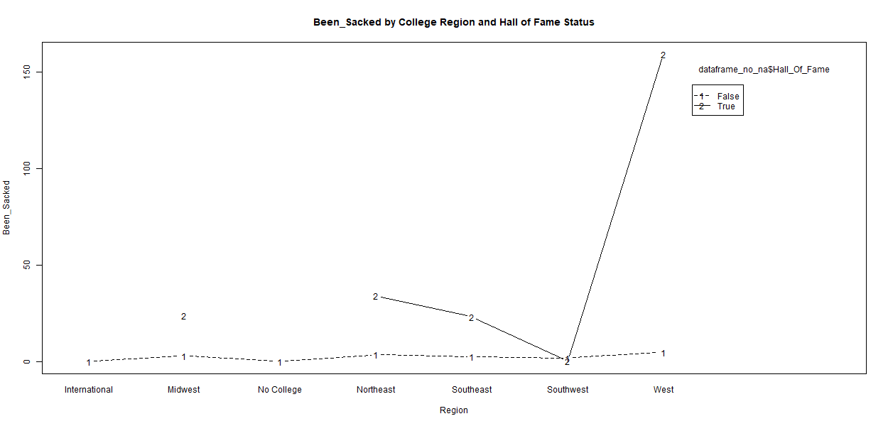
Models: Factorial ANOVA
Before Transformation

Slide 10
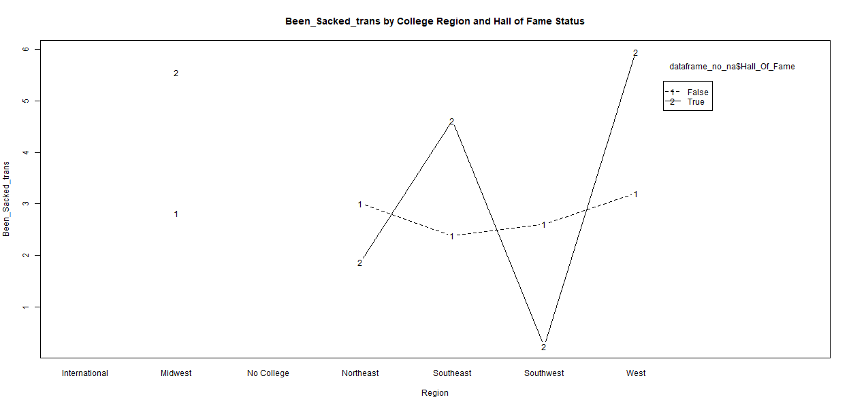
Models: Factorial ANOVA
After Transformation

Slide 11
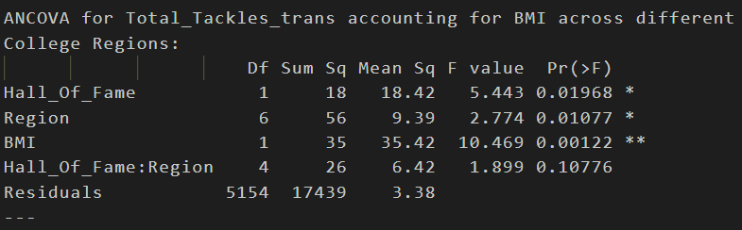
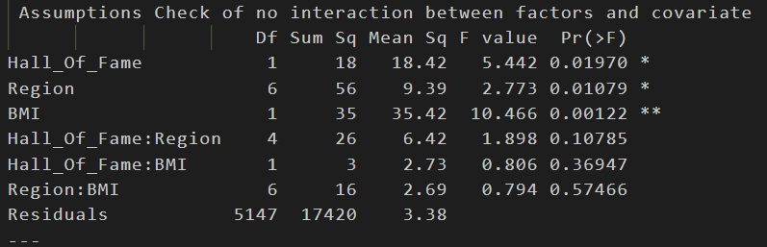
Models: ANCOVA
Test if the players college region and hall of fame status have a significant effect on performance metrics after controlling for BMI
Examined only retired players since players who retired in 2019 which would be recorded as retired in this data, are eligible for the 2024 hall of fame class
Functions created to test against all metrics, tests all assumptions and prints output to txt file. Function also works for offense and defense groups
BMI had no significant correlations with any of the metrics (see correlation plot
Variables with significant effects with no violations are
Total_Tackles_trans, Sacks_trans, Passes_Defended_trans, Forced_Fumbles_trans, Yrds_gained_per_Attempt_trans, Rushing_Yards_per_Attempt_trans,
Region and BMI seemed to be a common significant interaction

Slide 12
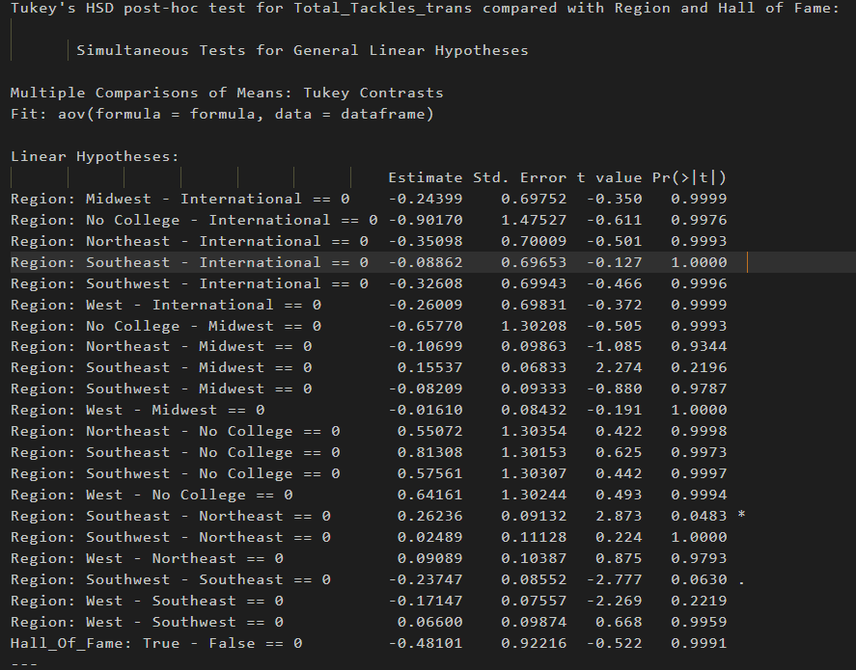
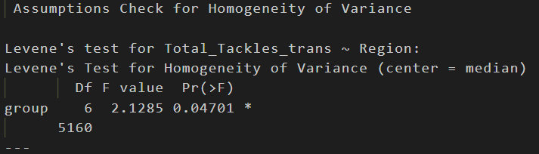
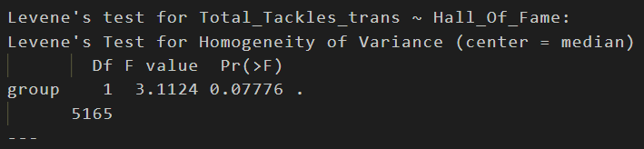
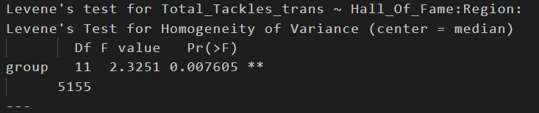
Models: ANCOVA

Slide 13

Questions?
My project GitHub
https://github.com/cjdrummond/Retired-NFL-Analysis

